Slide 1
Progress Meeting
METR4810
Team 10

Slide 2
Rover
To Buoy
Camera
Claw
Tracks

Slide 3
Buoy
Controller &
Transceiver
Winch
Comms cable attached to winch (mechanism TBC)
To Rover

Slide 4
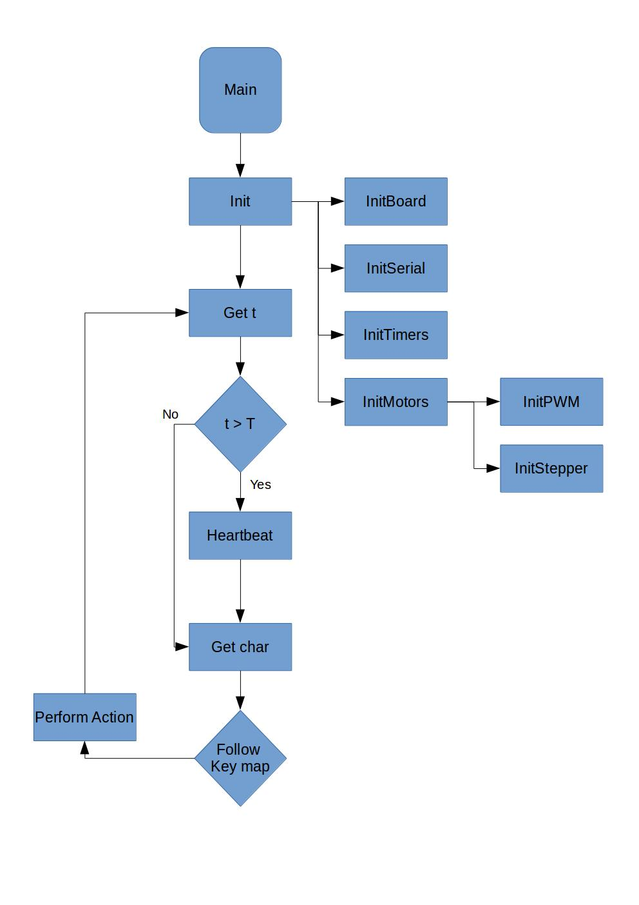
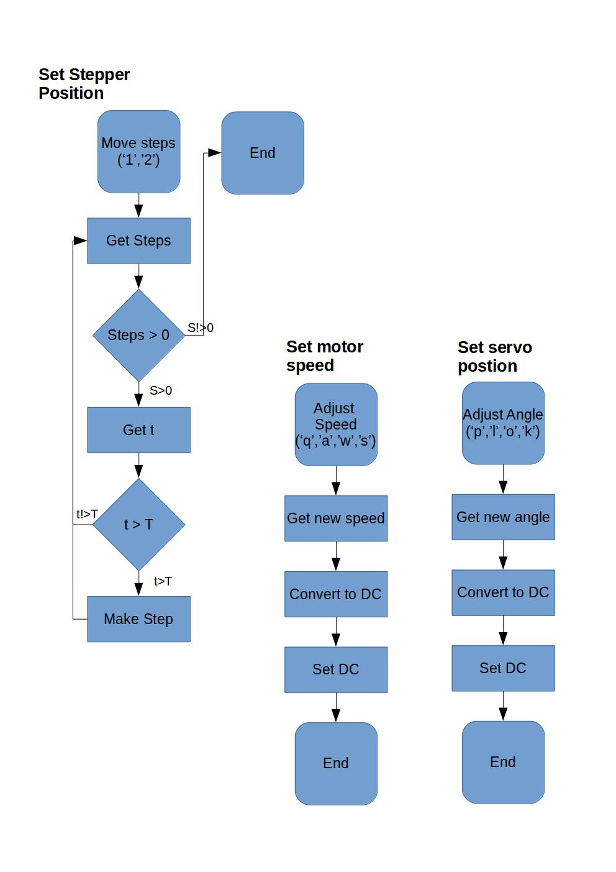
Process Flow Diagram

Slide 5
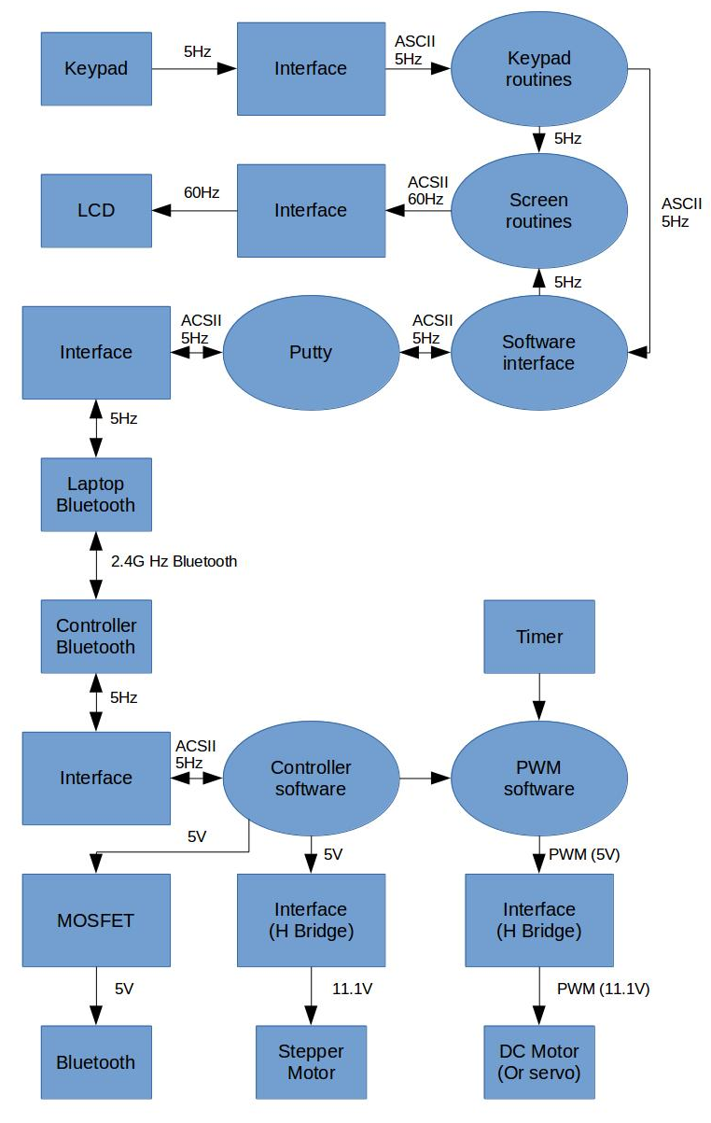
Signal Flow Diagram

Slide 6
Teleoperation and Buoy Design
Samuel Williams
43219667

Slide 7
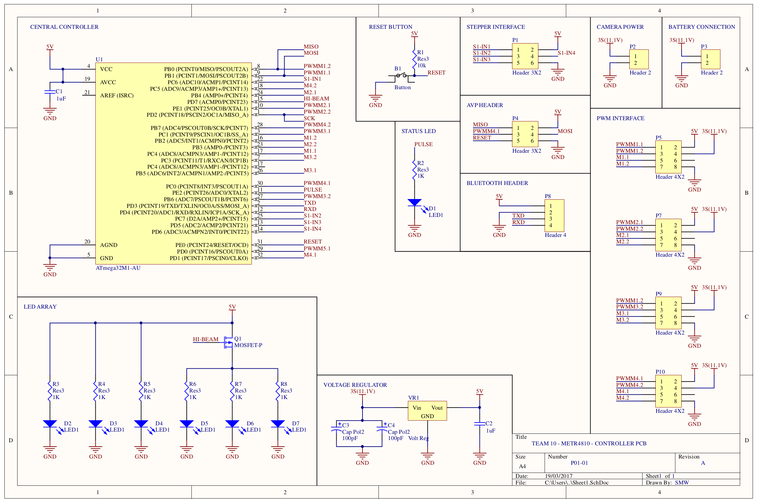
PCB Schematic Revision A

Slide 8
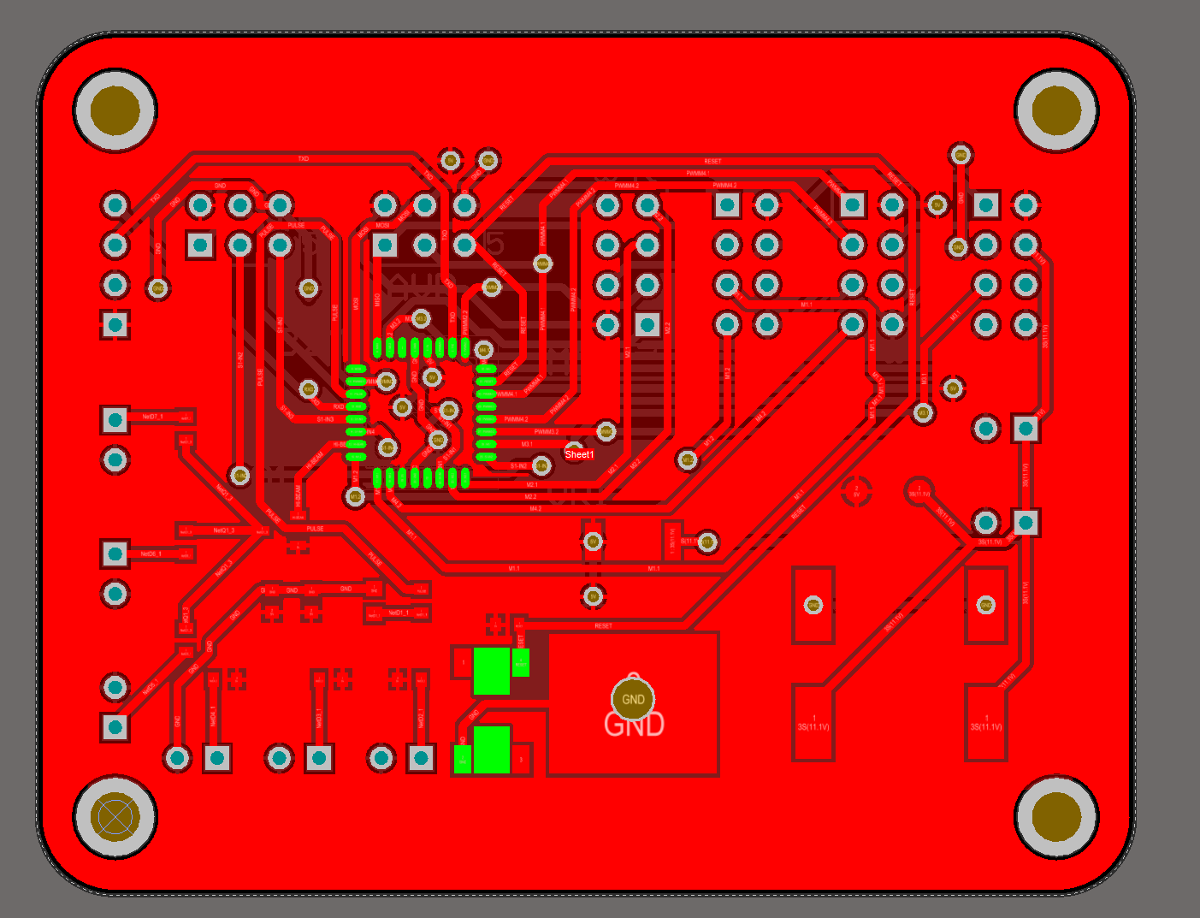
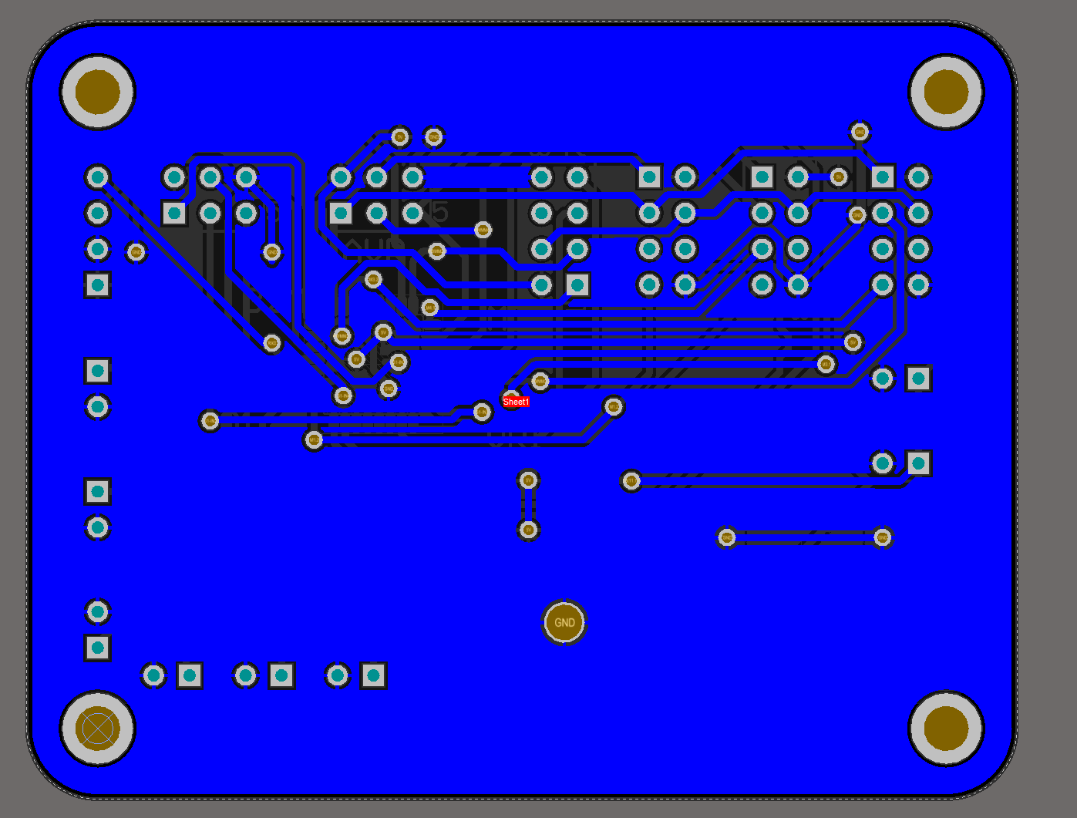
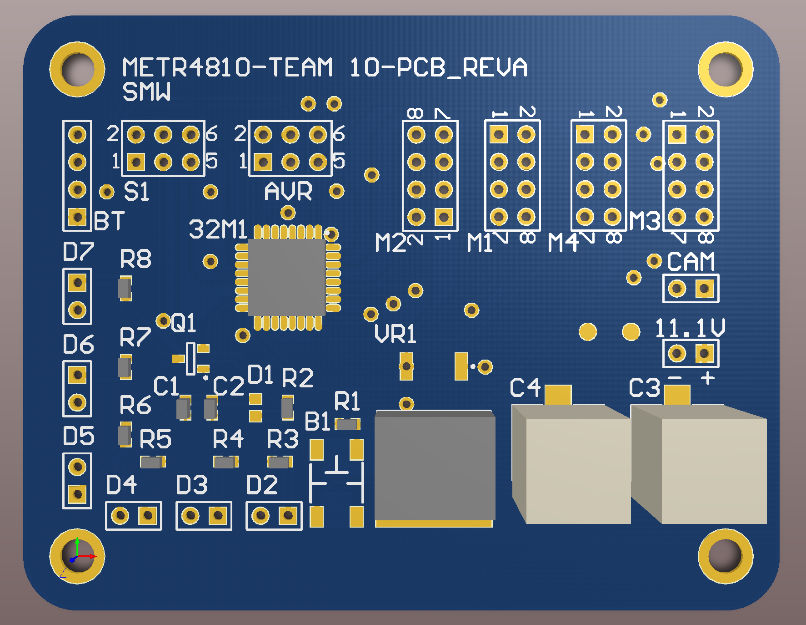
PCB Renders

Slide 9
Buoy Design

Slide 10
Camera and Interface Design
McKay Whight
43225819

Slide 11
WiFi camera feedback
Raspberry pi zero W (AUD 13)
Bluetooth and WiFi included
USB ports for webcams (AUD 25)
Specialized webcam csi connector (AUD 18)
Plenty of documentation for the system
VHS wireless rear view camera + VHS-USB converter (AUD 20)
WiFi included and functioning (out of the box)
Already waterproof (IP67IP68)
1.5 LUX LED included (1 lumen/m2)

Slide 12
Motors
Motors are controlled by an atmega324a
DC Motor
PWM driven and bidirectional. Input, duty cycle in clockwise or counter clockwise functions.
Servo Motor
PWM Driven, 0 to 180 degrees range. Input, angle position.
Stepper Motor
Bit-banging through ULN2003 (Darlington Pair). Input, steps in clockwise or counter clockwise.

Slide 13
Claw and Drivers Design
McKay Whight
43225819

Slide 14
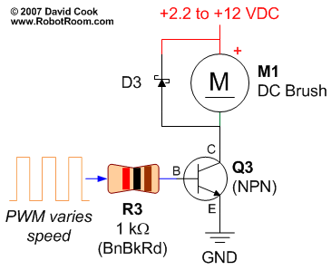
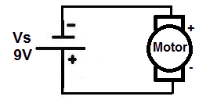
H bridge
Connected to power source DC motor can only in one direction.
However, controlled through transistor and PWM, motor can spin with variable speed..
..but, how to move backwards?
Solution: H-bridge

Slide 15
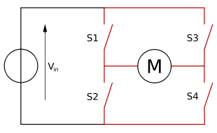
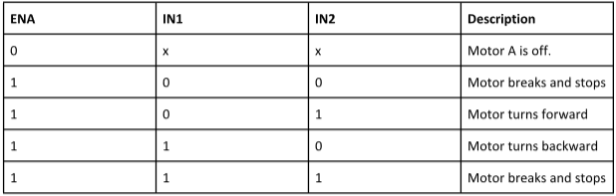
H bridge
Principle of an H bridge.
Replace each switch with a transistor.
S1 and S4 => IN1.
S2 and S3 => IN2.
Truth table:

Slide 16
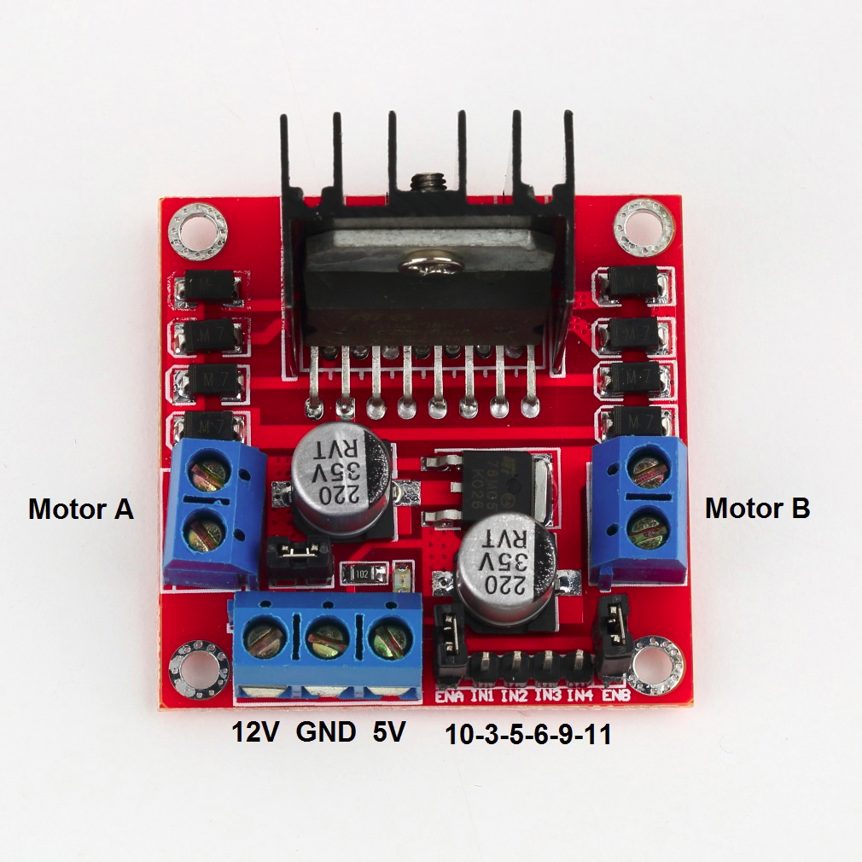
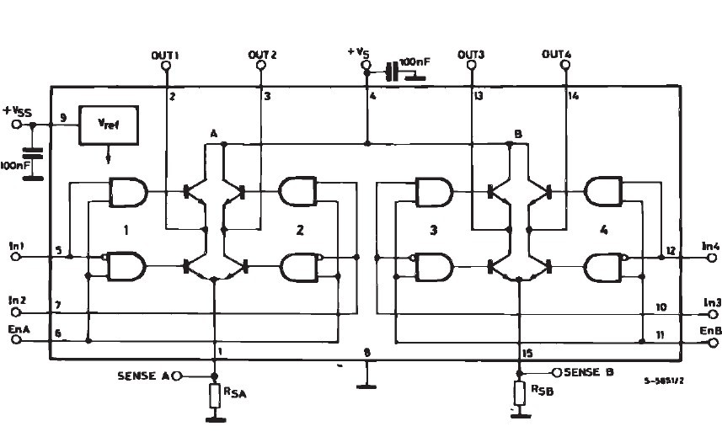
H bridge
In this project, we will use the motor driver l298n (double H bridge for 2 DC motors).

Slide 17
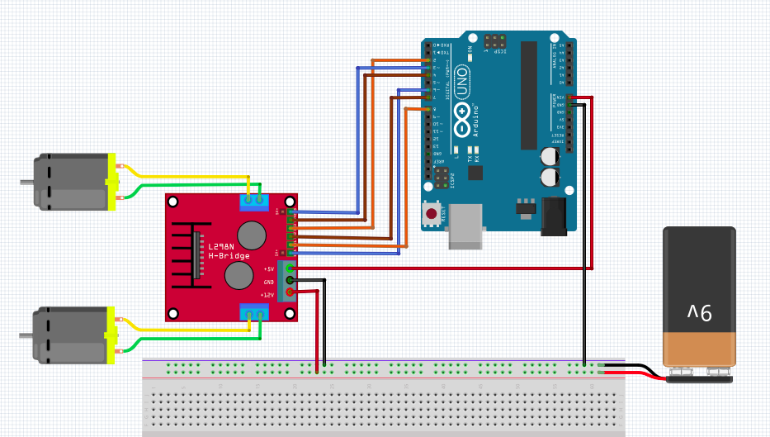
H bridge Circuit Concept

Slide 18
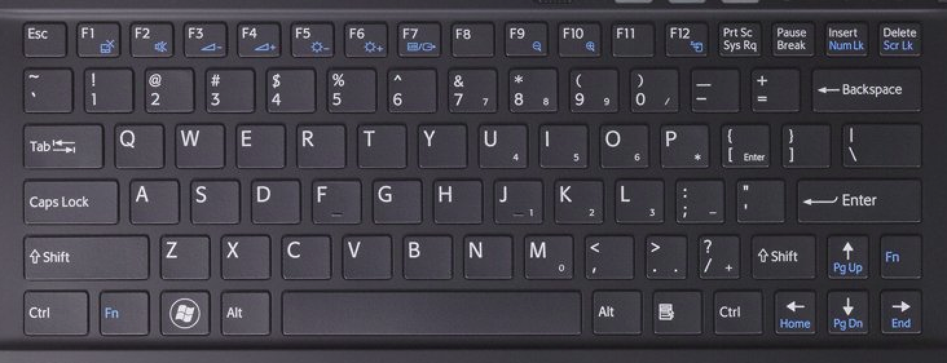
Commands from control station
Use of the keyboard to control the recovery system.
Implementation of a first version.

Slide 19
Commands from control station
Keyboard map.
Winch step up/down: ‚q‘ / ‚a‘.
Turn light on/off: ‚1‘ / ‚2‘.
Turn camera one step right/left: ‚x‘ / ‚z‘.
Raise/lower upper claw: ‚r‘ / ‚f‘.
Raise/lower lower claw: ‚t‘ / ‚g‘.
Move the car forwards/backwards: ‚i‘ / ‚m‘, stop the car: ‚k‘
Turn the car to the left/right: ‚j‘ / ‚l‘ (increasing the speed of one motor and decreasing the speed of the other motor).
3 different drive modes: duty cycle up to 255/255 => ‚y‘, duty cycle up to 190/255 => ‚h‘, duty cycle up to 130/255 ‚n‘.
Spinning the car to the left/right: ‚J‘ / ‚L‘

Slide 20
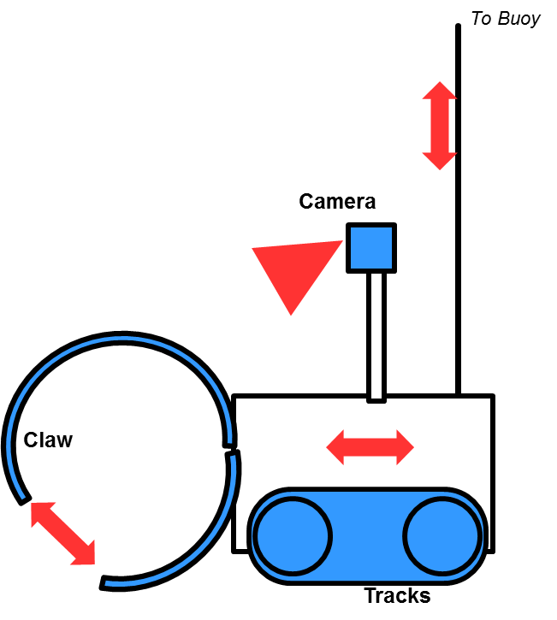
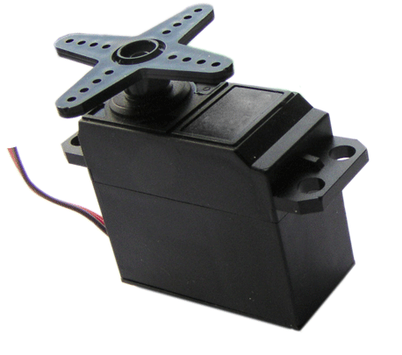
Claw
Two-part cylindrical claw from a PVC pipe:
Upper part: 3 quarters.
Lower part: 1 quarter.
Opening and closing through two servo motors, one for each part.
First prototype controlled through an Arduino.

Slide 21
Rover Design
McKay Whight
43225819

Slide 22
Design Objectives
Must be able to output enough torque to navigate unfavourable topologies underwater
Must maintain solid traction with sand/rocks at all times
Must be able to pivot 360 degrees
Motors must draw minimal current
Must be able to accommodate camera tower, claw attachment, rear propeller
Must be compact enough for manoeuvrability
Build simplicity

Slide 23
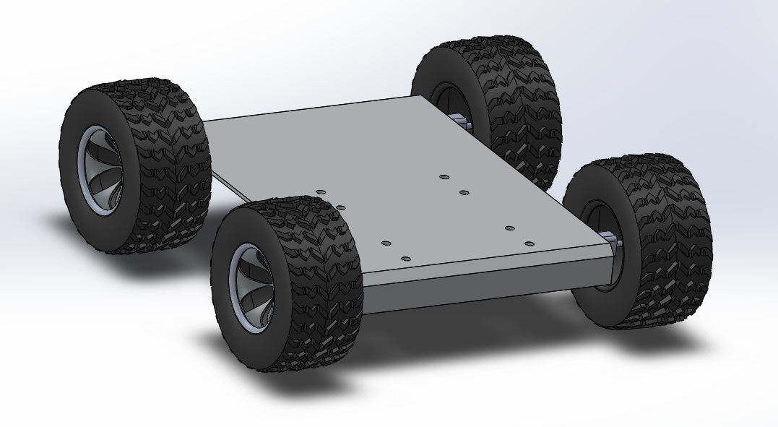
Design Concept

Slide 24
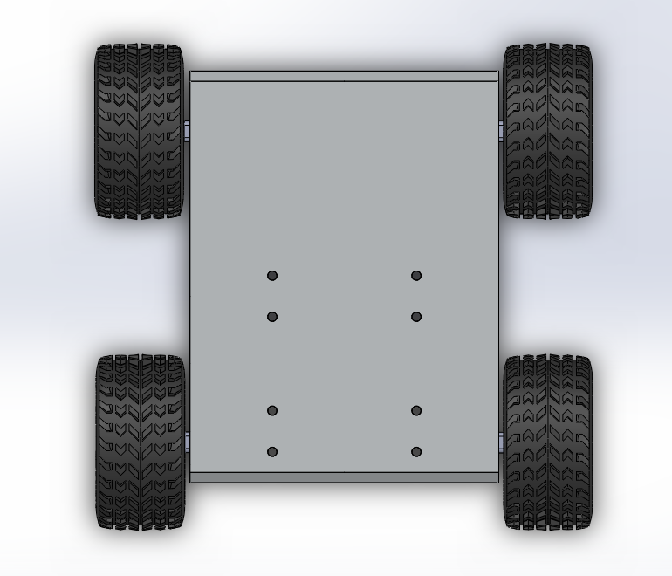
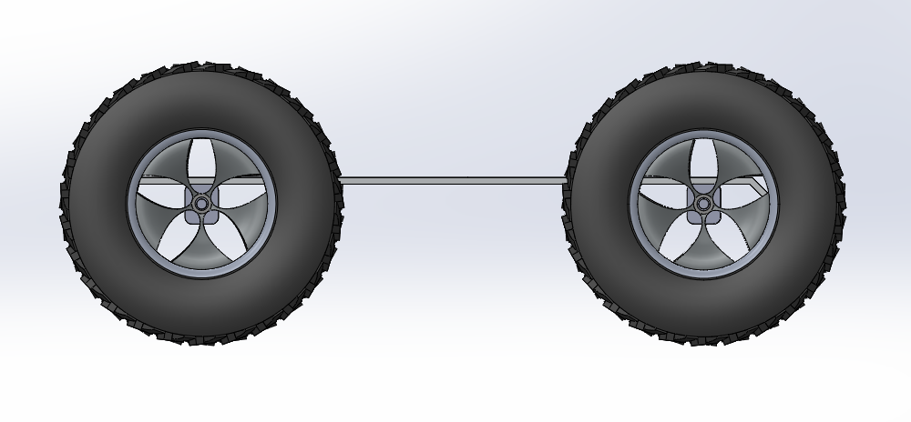
Side View
Top View
200mm
150mm
40mm

Slide 25
Current Design
4 Independent wheels
12V, 1000:1 DC Micro Metal Gear Motors on each wheel
80mm treaded off road tyres
Aluminium sheet frame
L298N dual H-bridge motor driver

Slide 26
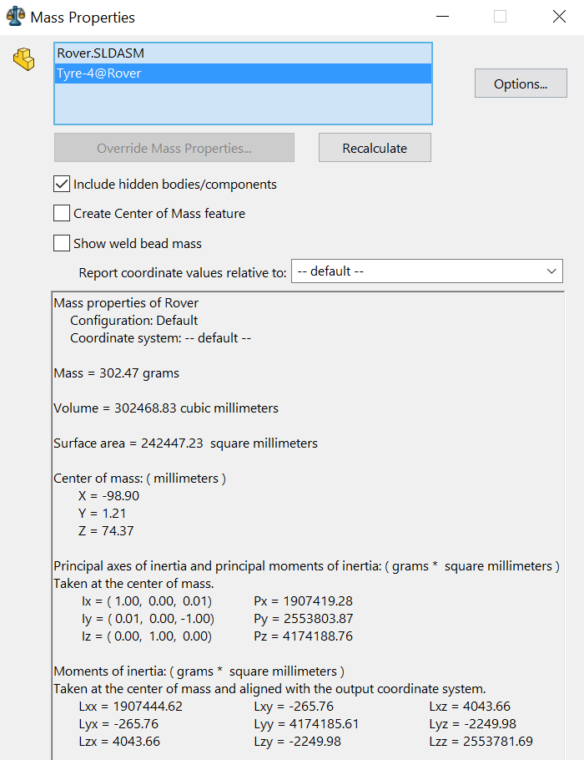
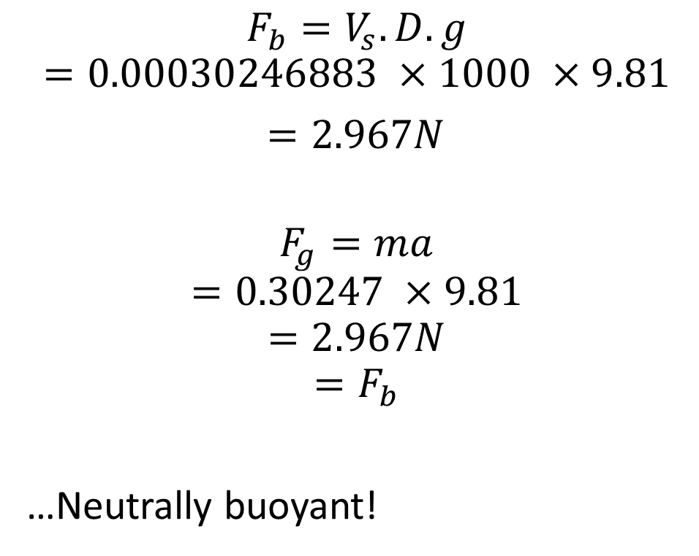
Buoyancy
$$F_{b}=V_{s}.D.g$$
$$=0.00030246883 ×1000 ×9.81$$
$=2.967N$
$$F_{g}=ma$$
$$=0.30247 ×9.81$$
$$=2.967N$$
$$=F_{b}$$
…Neutrally buoyant!

Slide 27
DC Motor Selection
Motor | Stall Torque (N-m) | Stall Current (A) | Free-Run Speed (RPM) | Cost /unit ($AUD) | Source
12V 298:1 Micro Metal Gear Motor | 0.49 | 0.8 | 100 | 3.59 | (1)
12V 1000:1 Micro Metal Gear Motor | 0.88 | 0.8 | 32 | 8.86 | (2)
Pololu 25D Metal Gear Motor | 2.12 | 5.6 | 100 | 9.00 | (5)
XD-37GB520 Metal Gear Motor | 4.12 | 2.19 | 100 | 15.34 | (3)
12V Techbrands YG-2734 | 1.17 | 1.38 | 36 | 19.95 | (4)

Slide 28
Battery Selection
Battery Type | Current Capacity (mAh) | Voltage (V) | Cost ($AUD)
LiPo | 1000 | 11.1 | 9.13
NiMH | 6400 | 11.5 | 4.40
LiPo | 2200 | 11.1 | 11.04

Slide 29
Motor Driver Selection
Motor Driver | Motor Voltage (V) | Continuous Current Supply per pin (A) | Motor Channels | Cost ($AUD)
L298N | 3 – 30 | 2 | 2 | 1.87
30A VNH2SP30 motor driver | 5.5-16 | 14 | 2 | 7.29

Slide 30
Sources
(1) – Pololu Robotics and Electronics. URL: https://www.pololu.com/product/3045
(2) – Pololu Robotics and Electronics. URL: https://www.pololu.com/product/3046
(3) – Little Bird Electronics. URL: https://littlebirdelectronics.com.au/products/metal-dc-geared-motor-12v-100rpm-42kg-cm
(4) – Little Bird Electronics. URL: https://littlebirdelectronics.com.au/products/12v-dc-reversible-gearhead-motors-36rpm
(5) – Pololu Robotics and Electronics. URL: https://www.pololu.com/product/3207/specs

